Slide 1
Comparison of Optimal Control Strategies for an Autonomous Boat
Ajay Chandra, Brandon Dimitri, William Popovich, Richard Yuan Fu
Notes:
Richard

Slide 2
Introduction and Motivation
Boating is expensive!
Initial purchase, upkeep, and fuel.
Average river motorboat gets around 3-12 mpg*.
Any sort of river crossing enterprise would save greatly from an optimal route through the current.
Faster times means happy passengers and more fuel efficient means thousands of dollars in savings.
*https://www.boatingvalley.com/average-boat-mileages-with-50-examples-of-different-boat-models/#:~:text=requires%20more%20fuel.-,Many%20small%20boats%20tend%20to%20get%20around%203%20%E2%80%93%2012%20mpg,will%20give%200.5%20%E2%80%93%202.5%20mpg.
Notes:
Richard

Slide 3
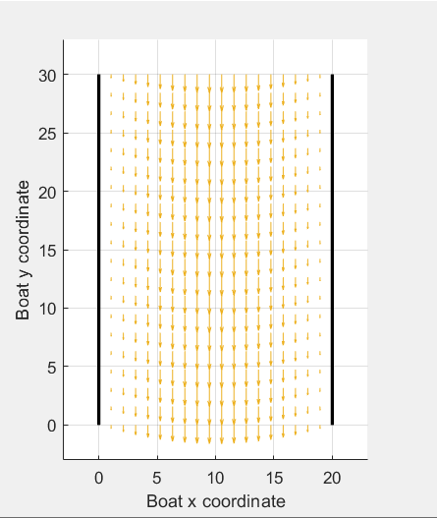
Problem Formulation
Zermelo's navigation problem with added complexity
More realistic river current
Higher fidelity modeling of boat dynamics
Control of throttle and rudder
Notes:
Richard

Slide 4
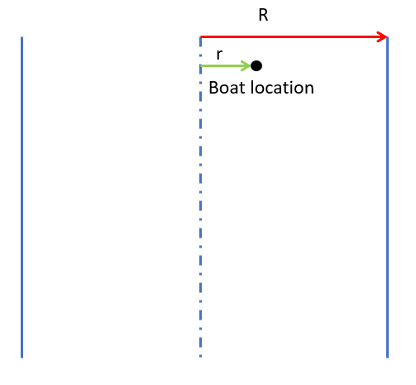

River Current
Modeled as a vector field
Shore
River
Shore
River centerline
Notes:
Richard

Slide 5
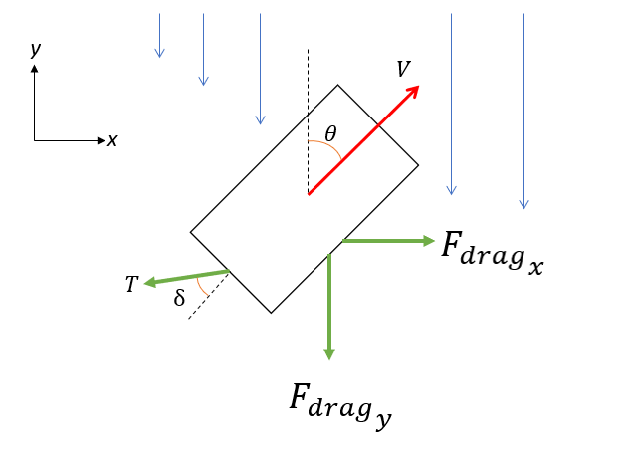
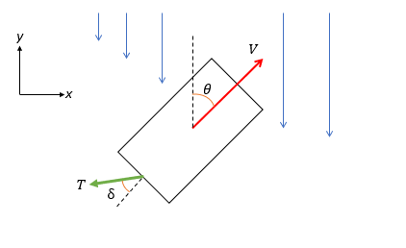
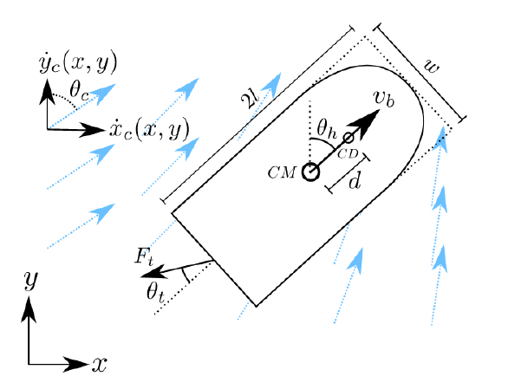
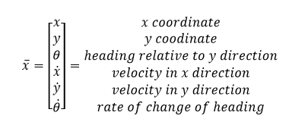

Dynamics
Notes:
Richard

Slide 6

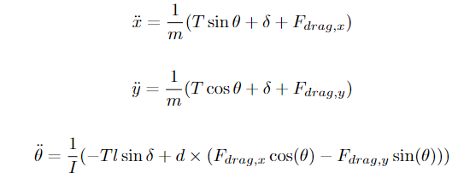


Dynamics
Drag force components in the x and y directions
Equations of Motion
Projected areas in the x and y directions
Moment of inertia
Notes:
Richard

Slide 7
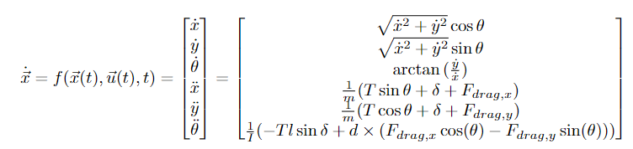
Dynamics
Notes:
Richard

Slide 8



Boundary Conditions
Fixed initial location
Fixed final location
Stationary start
Notes:
Richard

Slide 9
Attempted Control Strategies
Dynamic Programming
Nonlinear Model Predictive Control

Slide 10
Dynamic Programming
Notes:
Ajay

Slide 11
Dynamic Programming Methodology
Iterative minimal distance problem
Begin current location x_{i} at x₀
While x_{i} ≠ x_{f} (within error tolerance)
Apply all possible combinations of discrete thrust and rudder inputs
Iterate dynamics a few steps for each
The control input that ends with the smallest distance to xf left is the correct one
The result of this control is your new x_{i}
Notes:
Ajay

Slide 12
Dynamic Programming Methodology, continued
At the start of every time step
The boat can stay on the same heading or change its heading by 50◦ to the left or right
The boat can change its thrust by -10, 0, or 10.
Therefore, at the start of every time step, there are nine combinations of thrust and heading changes from which one can be chosen.
Notes:
Ajay

Slide 13
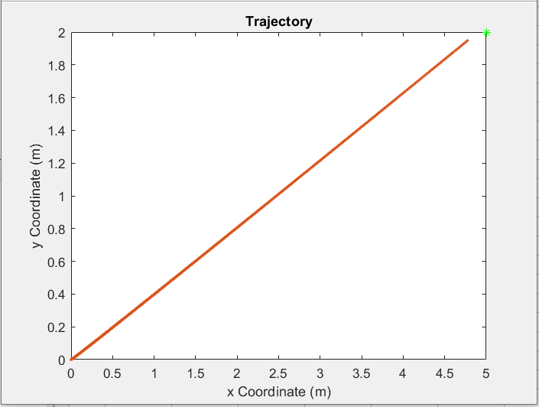
Dynamic Programming
Notes:
Ajay

Slide 14
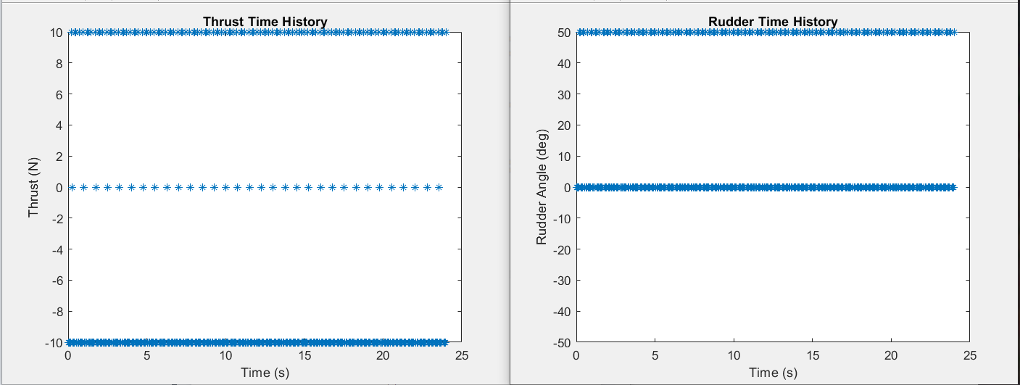
Dynamic Programming
Notes:
Ajay

Slide 15
Dynamic Programming Issues
Computationally Expensive
We ran with three possible thrusts and three possible rudder angles for nine possible control inputs to check at each time step
Need to keep the time step small enough that we don’t overshoot our end goal
Does not handle disturbances well
Controller does not see any river current, and can only handle small currents

Slide 16
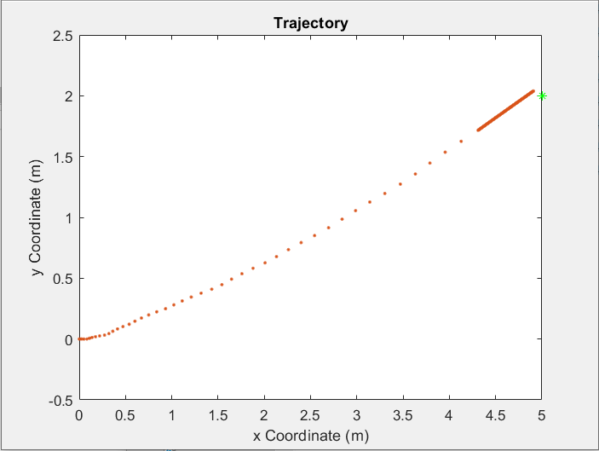
Dynamic Programming
Applying variable dt as we approach the final state
Diminishing returns as we lower our step.
dt = 0.003 to reach accuracy of 0.25
dt = 0.00005 to reach accuracy of 0.1

Slide 17
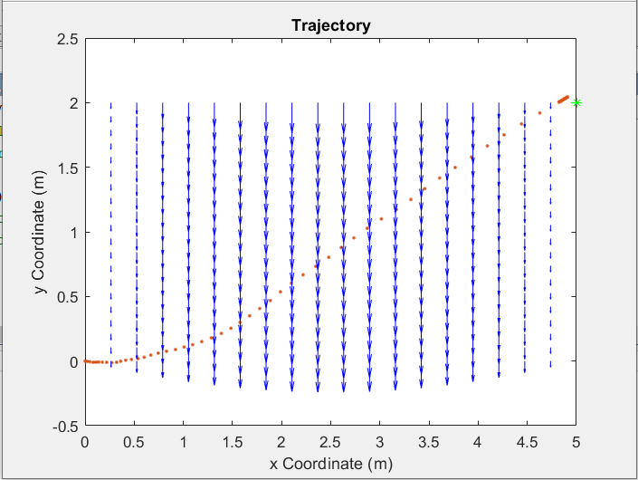
Dynamic Programming
Can withstand only small disturbances such as a current with peak absolute velocity=-0.001 m/s.

Slide 18
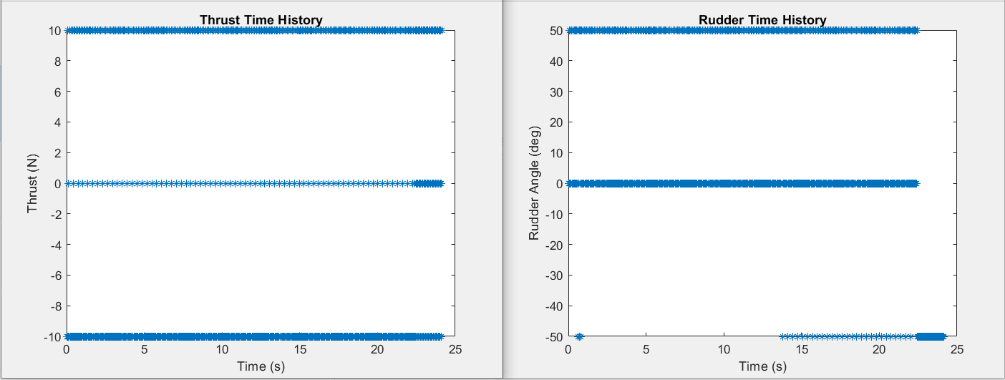
Dynamic Programming
Can withstand only small disturbances such as a current with peak absolute velocity = -0.001 m/s

Slide 19
Dynamic Programming Future Improvements
Add an estimator for disturbances such as the current.
Optimize coding approach, limit use of for loops.
Instead of smaller steps near end, also reduce how many steps are propagated for each control option:
Currently five.

Slide 20
Nonlinear Model Predictive Control

Slide 21
Nonlinear Model Predictive Control
Matlab toolbox for Model Predictive Control
Allows for nonlinear dynamics to be implemented in controller
Tuned using differing cost terms
Additional disturbances:
Wind
Current
GPS Noise
J = (x-x_{g})²*Q1 + (y-y_{g})²*Q2 + T²*R

Slide 22
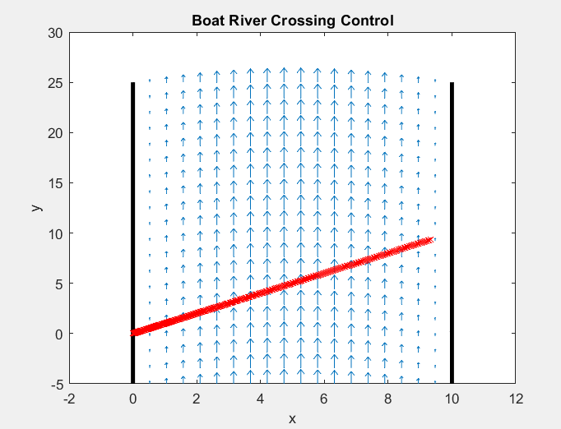
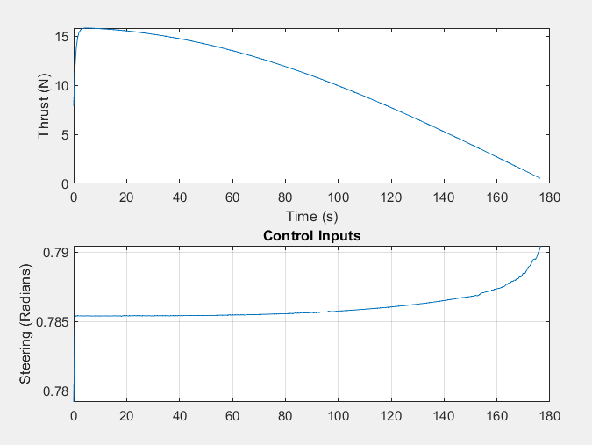
Q = 5 R = 5 Time = 176 s

Slide 23
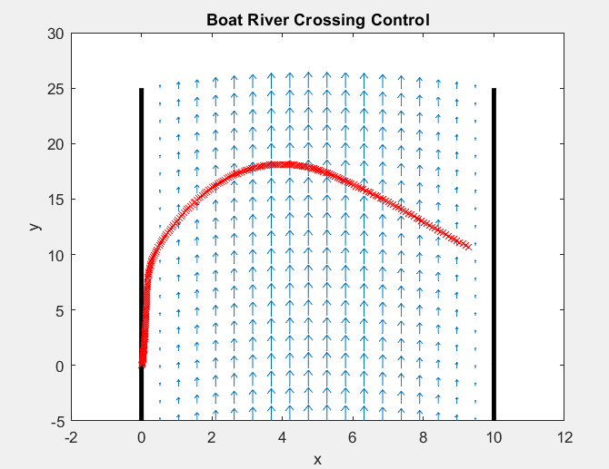
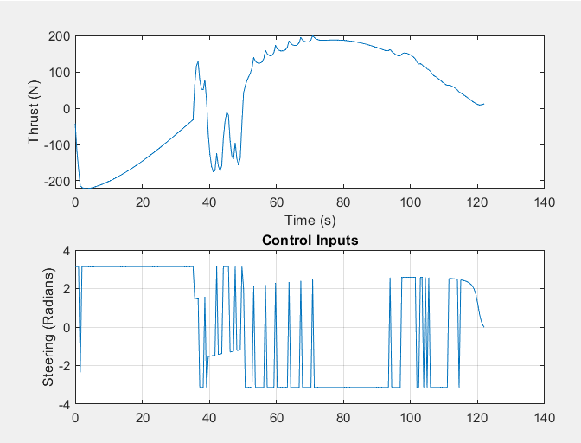
Q = 50 R = .01 Time = 122 s

Slide 24
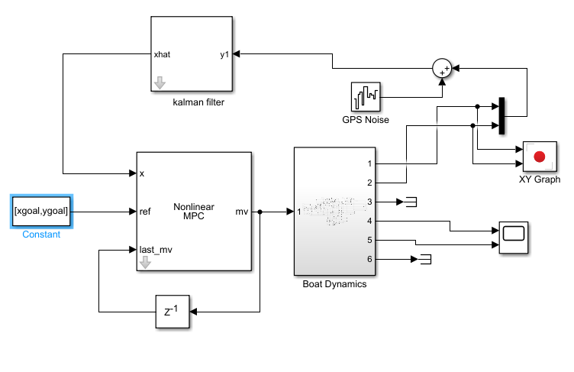
Future Work
Implement Kalman filtering to account for white noise disturbances
Sensor noise
Wing
Evaluate the performance of controller in different flows
Vortex flow
Reversed flow
Random flow
Evaluate performance for different initial and final conditions

Slide 25
Method Comparison

Slide 26
Method Comparison
Dynamic Programming:
Computationally expensive
Diverges easily in the presence of perturbation
Error at final state
Nonlinear Model Predictive Control:
More success in implementing more complicated dynamics
More robust against perturbation
More complicated cost function
Notes:
Ajay

Slide 27
Thank You

Slide 28
Supplementary Slides

Slide 29
Boat Characteristics
Parameter | Notation | Value
mass | m | 15000 kg
½ length | l | 8 m
width | w | 5 m
submerged depth of hull | h | 2 m
drag coefficient | C_{d} | 0.1

Slide 30
Assumptions
Current of the water does not change within the area of the boat for a given time step
The boat is shaped like a rectangle for the purposes of drag

